Slide 1
Case Study: Anorexia Nervosa in the Adolescent Male Patient
By Rachel Reid, Dietetic Intern
May 16, 2011

Slide 2
Overview
Introduction to Patient, DM
Anorexia Nervosa
Medical Complications
Nutrition Assessment
Nutrition Diagnosis
OHSU Guidelines Atypical Eating Disorders
Nutrition Interventions/ Monitoring and Evaluation
Outcomes and Summary

Slide 3
Patient DM: Overview of Eating Disorder
15 yo male in July of 2009
PCP confirmed 20 lb weight loss over 6 mos.
Restrictive eating and excessive exercise since March 2009.
Diagnosed with Anorexia Nervosa.
Parents admitted pt to Kaiser Eat Clinic.
Since, admitted and failed several treatment centers.
Readmitted to DCH for the 3rd time on 3/30/2011.

Slide 4
Anorexia Nervosa. An exaggerated desire for thinness (DSM-IV)
Symptoms Include:
1) Refusal to maintain a body weight above 85% of expected weight.
2) Intense fear of becoming fat with self-worth based on weight or shape.
3) Evidence of an endocrine disorder (amenorrhea for females, loss of sexual potency for males).

Slide 5
Prevalence of Anorexia Nervosa
The actual number of individuals affected is unknown.
- 0.3% of the population has all three symptoms
Anorexia Nervosa.
- .37% to 1.3% of the population has sub-
threshold Anorexia Nervosa (missing one
of the symptoms).
- 3.2% of young women (18 – 30 y.o.) are
diagnosed with an eating disorder.
- 10% of patients that are diagnosed with an
eating disorder are males.
**Numbers taken from International Journal of Eating Disorders

Slide 6
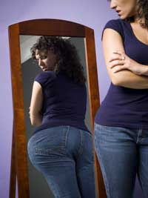
Risk Factors
No known etiology, however there are risk factors.
Dieting Behavior
Excessive Exercise
Past Abuse
Negative Self-Evaluation
High Level Perfectionism
Body Dysmorphic Disorder
Obsessive Compulsive Disorder
**56% risk assigned to
Genetic Predisposition

Slide 7
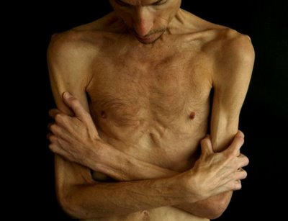
Anorexia Nervosa: Males
Clinical presentation similar, if not identical, to females.
Specific Differences in Males:
More feminine (attitude and behavior)
More closely identify with mothers
Many question gender identity,
sexual orientation
Afraid of sex
Homosexuals are over-represented

Slide 8
Behavioral Characteristics: Males
Compulsive exercise
Preoccupation with weight lifting, or muscle toning
Focus on certain body parts; e.g., thighs, stomach, abdomen
Difficulty eating with others
Preoccupation with food
Disgust with body size or shape

Slide 9
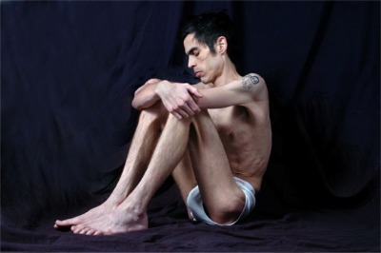
Physical Characteristics: Males
Low body weight (15% or more below expected)
Lowered body temperature, blood pressure, pulse rate
Tingling in hands and feet
Thinning hair or hair loss
Lanugo (downy growth of body hair)
Heart arrhythmia
Lowered testosterone levels
Insomnia

Slide 10
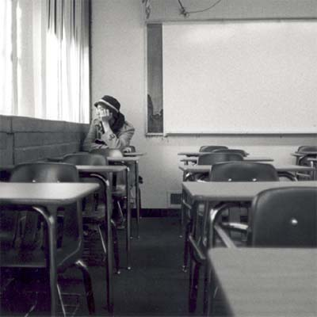
Emotional/Social Characteristics : Males
Depression
Social isolation
Strong need to be in control
Rigid, inflexible thinking, “all or nothing”
Gender identity conflict
Perfectionist
Irritability

Slide 11
DM’s History of Treatment
Aug 2009 | 9/22/2009- 9/30/2009 | Oct 2009 to July 2010 | 7/19/2010 – 10/1/2010 | 12/6/2010-12/14/2010 | 12/2010 – 2/4/2011
Outpatient Treatment | Inpatient Treatment | Outpatient Treatment & Day Treatment | Residential Inpatient Treatment | Inpatient Treatment | Residential Inpatient Treatment
Kaiser Eat Clinic | Doernbecher Children’s Hospital | Kaiser Eat Clinic St. Vincent | Seattle Center for Discovery | Doernbecher Children’s Hospital | Seattle Center for Discovery Left AMA
No Weight Gain, Little Success | Admit Wt: 44. 5 kg D/C Wt: 46.5 kg | No Weight gain, little success. Rec Residential Inpatient Center | Admit Wt: N/A D/C Wt: 55.45 kg IBW: 58.5 kg | Admit Wt: 50.3 kg D/C Wt: 51.2 kg | Admit Wt: 51.2 kg D/C Wt: 53.18 kg

Slide 12
Admission to DCH on 3/30/11
**Admitted for weight loss and bradycardia**
5% weight loss in 2 months
Heart Rate: 42 bpm

Slide 13
Patient’s History
Social History
Parents divorced - Joint custody.
Different parenting styles.
Very few friends. Withdrawn personality.
Values physical fitness and health.
Failed to make high school BB team October 2008.
Family History
Father’s nieces diagnosed with anorexia nervosa.
Mom and Dad treated for depression and anxiety.
Psychiatric History
Saw a counselor d/t social isolation.
Per father, pt cannot ever relax, anxious.

Slide 14
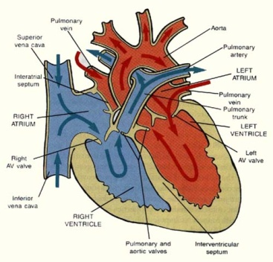
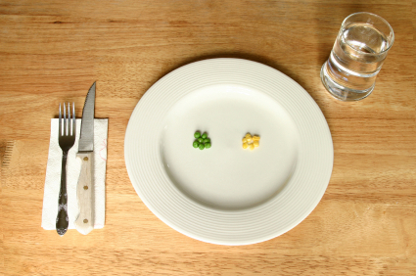
Eating Disorders Are: Complicated
Behavioral
Psychological
Physiological
Requires a Multidisciplinary Approach:
Psychological (Psychologist, Social Worker)
Medical (Physician)
Nutritional (Dietitian)

Slide 15
3/30: MD’s Initial Assessment and Plan
Start with Phase 2 Eating Disorder Protocol
Start with 1800 kcal diet tonight, Nutrition consult in the AM.
Adolescent Medicine Consult
Child Psychology Consult
Check Labs per protocol (daily AM phos)
Boost overnight for Bradycarida

Slide 16
ED Protocol At Doernbecher
ED patients put on a protocol (4 Phases):
 | Phase 2 (Most admits)
Activity | Bed Rest Wheelchair @ school
Meals | Meals in bed • Meals are pts medicine, must be on time, no substitutions • Complete meal in 30 minutes
Sitters | Sitter at all times, parents can not act as sitter

Slide 17
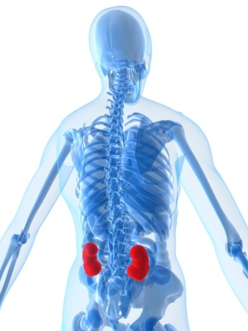
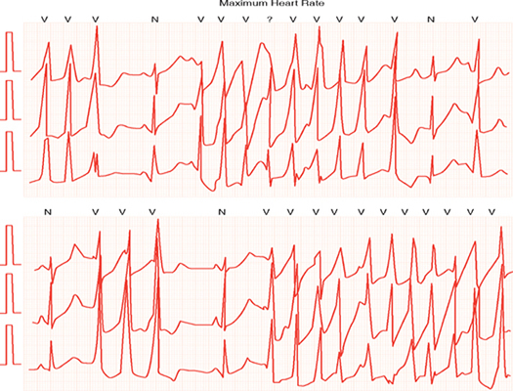
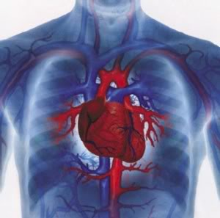
Medical Management
Most serious complications exhibited by DM.
Growth stunting of organs: Kidneys
Cardiac Issues
Refeeding Syndrome

Slide 18
DM’s Renal Function 12/2010 Renal Ultrasound: Small Kidneys
High Creatinine levels:
Creatinine clearance: 88.9 (L)
High BUN levels:
**Pt referred to a Kaiser Nephrologist after d/c
Reduced renal function reported in severe energy restriction.
- growth stunting
- electrolyte imbalances (hypokalaemic nephropathy)
- rhabdomyolysis – excessive exercise (2009 case report)
3/30 | 3/31 | 4/4 | 4/5 | 4/7
1.28 | 1.30 | 1.26 | 1.47 | 1.24
3/30 | 3/31 | 4/4 | 4/5 | 4/7
18 | 21 | 23 | 22 | 21

Slide 19
DM’s Cardiac Complication
80% Anorexic patients have cardiac complications.
Sinus Bradycardia: Under 50 bpm
- Caused by a malnourished, weak heart
Other Possible Complications:
- Arrhythmia
- Orthostatic (Change in blood pressure)
 | 3/30 | 3/31 | 4/1 | 4/2 | 4/3 | 4/4 | 4/5 | 4/6 | 4/7
HR | 42 | 45 | 43 | 43 | 49 | 71 | 72 | 68 | 68
Low | 35 | 33 | 35 | 35 | 35 | 39 | 34 | 43 | 41

Slide 20
DM’s Risk for Refeeding Syndrome
Refeeding Syndrome: Severe (potentially fatal) electrolyte and fluid shifts associated with metabolic abnormalities in malnourished patients.
Phosphorous:
Can result in cardiac complications or arrest.
3/30 | 3/31 | 4/1 | 4/2 | 4/3 | 4/4 | 4/5 | 4/6 | 4/7
3.6 | 4.1 | 3.9 | 3.5 | 3.3 | 2.9 | 3.5 | 3.1 | 2.6

Slide 21
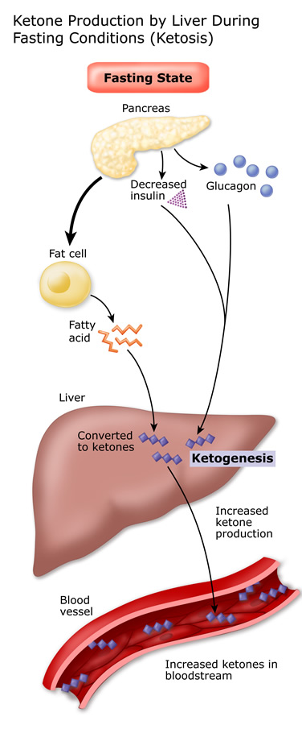
Refeeding Syndrome Cont.
Fasting State: Catabolism
Processes: Glycogenolysis,
Gluconeogenesis, Lypolysis
Energy = Protein and Fat (Ketones)
Several intracellular minerals become
severely depleted.
However, serum concentrations of these
minerals may remain normal.

Slide 22
Refeeding Syndrome Cont.
Fed State: Synthesis
Processes: Synthesis of glycogen, fat and protein.
Requires minerals (phos, mg) and cofactors.
Insulin stimulates absorption of K, Mg, Phos into cell.
Water is drawn into cell by osmosis.
Decreases serum levels of K, Mg and Phos further.
Result: Clinical features of Refeeding Syndrome.

Slide 23
Hospital vs. Residential/Outpatient Goals
Hospital Treatment Goals:
Residential/Outpatient Treatment Goals:
Weight gain
Identify and address psychosocial factors.
Extensive Counseling.
Teaches patient how to healthfully approach food and eating
Stabilization of vital signs
Meeting goal calorie requirements
Discharge!

Slide 24
Nutrition Assessment
Physical:
Thin, cachectic appearing 17 y.o. male
Temporal Wasting
Cyanosis of hands
Dry skin and some bruising on vertebrae, per MD
Anthropometrics:
Height: 165.1 cm (5’5”) 8th %ile
Weight: 48.4 kg (106 lbs 11.2 oz) < 3rd %ile
Ideal Body Weight at 50th %ile: 58 kg (83% IBW)
Weight for Age (%): 2.06%ile
BMI: 17.6 kg/m^2
BMI for Age (%): 6.23 %ile

Slide 25
Growth Chart: BMI (15 – 17 yo)

Slide 26
Nutrition Assessment
Patient Says:
He feels “mentally stronger”.
Feels like “a million bucks” physically.
Low heart rate just a “speed bump” in healing process.
Following meal exchanges, breakfast a little smaller.
Does not think he exercises excessively (occasional dumb bells, walk, b-ball).

Slide 27
Nutrition Assessment
Father Says:
Still very anxious
Can’t sleep at night
Consistently not meeting his exchange list goals
Excessively exercising (hears him running in place, lifting weights in room, etc.)
Believes he is OCD about his food.

Slide 28
Nutritional Assessment: Intake
Pt: “I have a new, healthy relationship with food.”
24 Hour Recall: Indicated intake of 1050 kcals.
Breakfast: Oatmeal
Snack: Maybe handful of pretzels
Lunch: ½ Turkey Sandwich
Dinner: 1 c veggies, 3 oz chicken breast, 1 c rice
Food Preferences:
“Whole foods”: beans, rice, vegetables, meat.
Dislikes fried, processed, fatty foods.
Soy milk instead of regular milk

Slide 29
Nutritional Assessment: Initial Labs
Labs | 3/30/11 | 3/31/11
Na | 138 | 138
K | 3.8 | 4.2
Cl | 98 | 102
CO2 | 32 (H) | 30 (H)
BUN | 18 | 21 (H)
Glu | 98 | 74
Cr | 1.28 (H) | 1.30 (H)
Calcium | 9.3 | 9.1
Mg | 2.3
Phos | 3.6 | 4.1
Alb | 4.2
TG | 47
BUN and Cr: Renal Function
Electrolytes: Appear Stable
Monitor: Phosphorous
CO2: Metabolic Alkalosis, Renal Function?
Notes:
CO2 may indicate fat oxidation rather than carbohydrate oxidation for energy.

Slide 30
Nutrition Assessment: Hydration
Evaluate hydration status based on urine.
Specific Gravity: measures the concentration of all chemical particles in the urine.
Normal Range: 1.005 – 1.030
Under 1.005 overhydrated
Over 1.030 underhydrated
 | 3/30 | 3/31 | 4/1 | 4/2 | 4/3 | 4/4 | 4/5 | 4/6
SG | 1.010 | --- | 1.010 | 1.025 | 1.020 | 1.010 | 1.010 | 1.010

Slide 31
Nutrition Assessment: Estimated Needs
Energy Requirements:
Catch-up growth RDA X desirable weight (using BMI @ 50th%ile (IBW))
45 kcal/kg x 58 kg (IBW) = 2600 kcal
Protein Requirements:
RDA x Desirable Weight
1.0 g/kg x 58 kg = 58 g PRO
Fluid Requirements:
(48.4 kg-20) x 20 +1500 = 2050 ml minimum

Slide 32
Nutrition Diagnosis
PES Statement:
Inadequate oral intake related to restricting calories as evidenced by inappropriate weight loss, 83% of IBW, and 24 hour recall indicating intake of 1050 kcals.

Slide 33
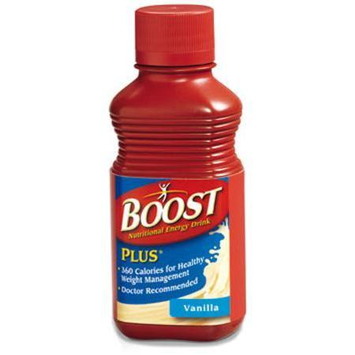
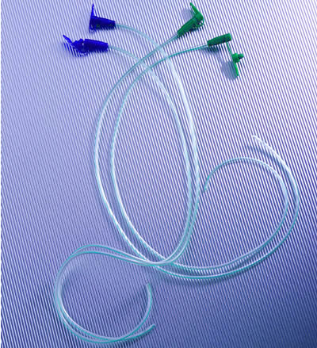
OHSU Nutrition Guidelines: Atypical Eating Disorders
Achieve calorie and protein goals orally with general diet.
Boost Plus if refuses food.
If unable to achieve, give by tube.
250 mls Boost Plus overnight for bradycardia (not added to calories)

Slide 34
OHSU Nutrition Guidelines
4. Patient to select 5 foods they don’t want to receive. May not select food groups (fats, fried foods).
DM’s 5 Foods:
Milk
French Fries
Hamburgers
Chicken Strips
Cookies

Slide 35
OHSU Nutrition Guidelines
5. RD selects daily menus for patient.
Menus should be balanced and provide 3 servings per day of dairy.
DM: Soy Milk or Yogurt
Menu Example

Slide 36
Nutrition Interventions for DM
Goal: Optimal Nutrition
Set up meal plan with 1200 kcals per day. Increase intake by 200 – 300 kcal/day to goal.
Recommend checking Vitamin D
Initiate Calorie Count (Manager Check)
Meds: TUMS, MVI, Zinc

Slide 37
Monitor and Evaluate
RD Monitors Everyday…
1. Attain adequate intake of goal calories daily
- Calorie count (completed daily by RSA)
- Increase calories by 300 kcal/day
2. Weight Gain
- AM weights taken daily
- Indicator: Increase by 100 – 200 g/day
3. Monitor Refeeding Syndrome
- Daily phosphorous labs will be drawn
- Indicator: Phos WNL

Slide 38
Monitor and Evaluate
Day 3: 1500 kcal, 480 ml per shift (48 oz per d)
Pt eats 100% of meals, feeling full.
Needed Boost overnight for HR of 33.
Phos WNL, Vit D and Zinc WNL
Testosterone 46 L
Changed goal kcals to 3200 kcal
Day 4 – 5 (Weekend): 1800, 2100 kcal
Pt eats 100% meals, feeling full.
No Boost overnight
Phos WNL

Slide 39
Monitor and Evaluate
Day 6: 2400 kcal
Pt continues to eat 100% meals, feeling full.
Phos trending down (2.9), rec replete with NutraPhos.
 | Day 1 | Day 2 | Day 3 | Day 4 | Day 5 | Day 6 | Day 7
Na | 138 | 138 |  |  |  | 133 (L) | 134
K | 3.8 | 4.2 |  |  |  | 3.7 | 3.9
Co2 | 32 (H) | 30 (H) |  |  |  | 28 | 25
BUN | 18 (H) | 21 (H) |  |  |  | 23 (H) | 22 (H)
Cr | 1.28 (H) | 1.3 (H) |  |  |  | 1.26 (H) | 1.47 (H)
Mg | 2.3 |  |  |  |  | 2.0
Phos | 3.6 | 4.1 | 3.9 | 3.5 | 3.3 | 2.9 | 3.5

Slide 40
Monitor and Evaluate
Day 7: 2600 kcal
Continues to eat 100% of meals.
Received Boost overnight for low HR.
Discussed possible 3rd snack, not accepted.
Moved bedtime snack to 9:30 pm.
Day 8: 2900 kcal
Continues to eat 100%
Requested to move snack time to 3:15, and dinner at 6:15pm

Slide 41
Monitor and Evaluate
Day 9: 1st Day on Goal Calories (3200 kcal)
Continues to eat 100% of his meals, did not receive Boost overnight.
Willing to meet with parents to develop a plan to meet nutrition goals at home.
Discharge Meeting.

Slide 42
Daily Weights
D/C at +100 gm from admit
Why do you think this happened?
3/30 | 3/31 | 4/1 | 4/2 | 4/3 | 4/4 | 4/5 | 4/6 | 4/7
48.8 kg | 48.4 kg | 47.9 kg | 47.6 kg | 47.5 kg | 47.87 kg | 48.2 kg | 48.4 kg | 48.9 kg
1800 kcal | 1200 kcal | 1500 kcal | 1800 kcal | 2100 kcal | 2400 kcal | 2600 kcal | 2900 kcal | 3200 kcal

Slide 43
Catabolic state → Anabolic state
Anorexics have a low RMR so weight gain should be easy right?
During refeeding, RMR increases significantly, making weight gain difficult.
Weight gain is seen usually after the first 5 to 7 days of refeeding.

Slide 44
Remember Inpatient Goals?
On 4/7:
Vital Signs Stable.
Met Goal Calories.
Discharged.
We do not fix them here, we stabilize them.

Slide 45
Discharge Meeting…
RD met with parents and patient.
Tension in the room.
Given exchange list for 3200 kcals.
Patient did not want make up calories from Boost, rather with “real food”.
Parents very knowledgeable about the system.
Contract was signed:
Will follow 3200 meal plan, will allow parents to make up kcals
Limit physical activity
1 distraction (get a job)

Slide 46
Outcomes for AN Patients
1/2 are expected to recover.
Other 1/2 either experience:
A moderate response to treatment (21%).
A poor outcome (29%).
Highest mortality out of all psychiatric disorders… 9.8%.

Slide 47
As far as DM’s future goes…
No discharge to
treatment center.
An appointment with
an RD on 4/16/11.
DCH RD asked for
f/u call in 1 week.
- Did not receive phone call.

Slide 48
Summary
Pt admitted with bradycardia and weight loss
Presented with renal and cardiac abnormalities d/t growth stunting
Nutrition Interventions Included:
Initial energy: 1200 kcals, increased 2 – 300/day
D/C’d first day on goal calories
Discharge Meeting: 3200 kcal exchange list
No f/u phone call received

Slide 49
Questions?

Slide 50
References
Position of the American Dietetic Association: Nutrition Intervention in the Treatment of Anorexia Nervosa, Bulimia, and Other Eating Disorders. J Am Diet Assoc. 2006;106:2073-2082.
National Eating Disorders Association. Males and Eating Disorders Research. www.neda.org. Retrieved May 1, 2011.
DSM-IV. American Psychiatric Association. (1994). Diagnostic and Statistical Manual of Mental Disorders (4th ed.). Washington, DC.
Estimation of Renal Disorders in Patients with Anorexia Nervosa. Int J Eat Disord 2011; 44:233–237.
Lucas AR, Crowson CS, O’Fallon WM, Melton LJ. The ups and downs of anorexia nervosa. Int J Eat Disord. 1999;26:397-405.
Bulik CM, Teba L, Siega-Riz AM, Reichenborn-Kjennerud T. Anorexia nervosa: Definition, epidemiology, and cycle of risk. Int J Eat Disord. 2003;34: 383-396.
Manzato E, Mazzullo M, Gualandi M, Zanetti T, Scanelli G. Anorexia nervosa: From purgative behaviour to nephropathy. A case report. Cases J. 2009;2(3):46.
Mehanna H, Nankivell P, Moledina J, Travis J. Refeeding syndrome – awareness, prevention and management. Refeeding Syndrome: Awareness, prevention and management. Head Neck Oncol. 2009; 1: 4.
Lock J, Le Grange D, Agras, S, Moye A, Bryson S. Randomized Clinical Trial of Family-Based Treatment versus Adolescent-Focused Individual Treatment for Patients with Eating Disorders. PhDArch Gen Psychiatry. 2010;67(10):1025-1032

